Slide 1


Playlist Management Using Doubly Linked List
NAME: G VENKATA GANESH
REG.NO: 192425381
COURSE CODE: CSA0310

Slide 2
Problem Statement
A music streaming application maintains a playlist where songs can be:
Added dynamically
Removed easily
Reordered anytime
Played sequentially
The application requires a data structure that provides flexibility and efficient updates.

Slide 3
Recommended Data Structure
Doubly Linked List
A Doubly Linked List stores each song as a node containing:
Song information
Pointer to previous song
Pointer to next song
Why Doubly Linked List?
Dynamic memory allocation
Easy insertion and deletion
Supports forward and backward navigation

Slide 4
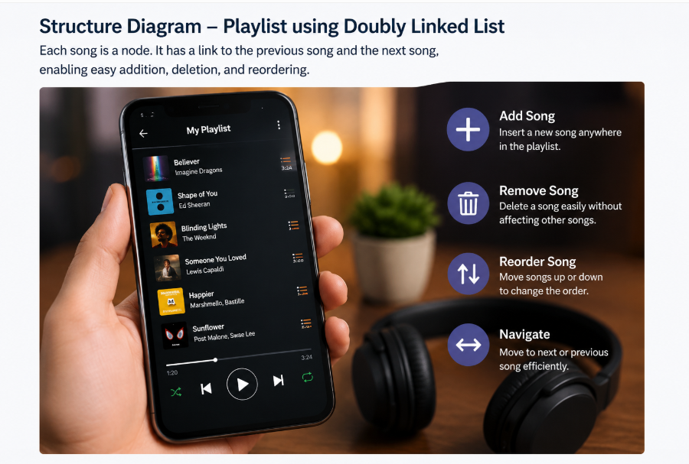
STRUCTURE DIAGRAM

Slide 5
Operations
Operation | Time Complexity
Add Song | O(1)*
Remove Song | O(1)*
Move/Reorder Song | O(1)*
Search Song | O(n)
Traverse Playlist | O(n)
*When the node position is already known.

Slide 6
Justification
Why Doubly Linked List?
Flexibility
Songs can be inserted anywhere.
Songs can be deleted easily.
Playlist size grows dynamically.
Efficiency
No shifting of elements.
Supports Previous and Next buttons.
Fast updates compared to arrays.

Slide 7
ADVANTAGES
Dynamic playlist size
Efficient insertion and deletion
Easy song reordering
Forward and backward navigation
Better user experience
Memory allocated as needed

Slide 8
Conclusion
The Doubly Linked List is the most suitable data structure for playlist management because it provides:
Efficient insertion and deletion
Flexible song reordering
Bidirectional navigation
Dynamic memory usage
Improved performance for music streaming applications

Slide 9
THANK YOU

